Slide 1
Aa
Bb
Cc
Dd

Slide 2
Aa
Bb
Cc
Dd

Slide 3
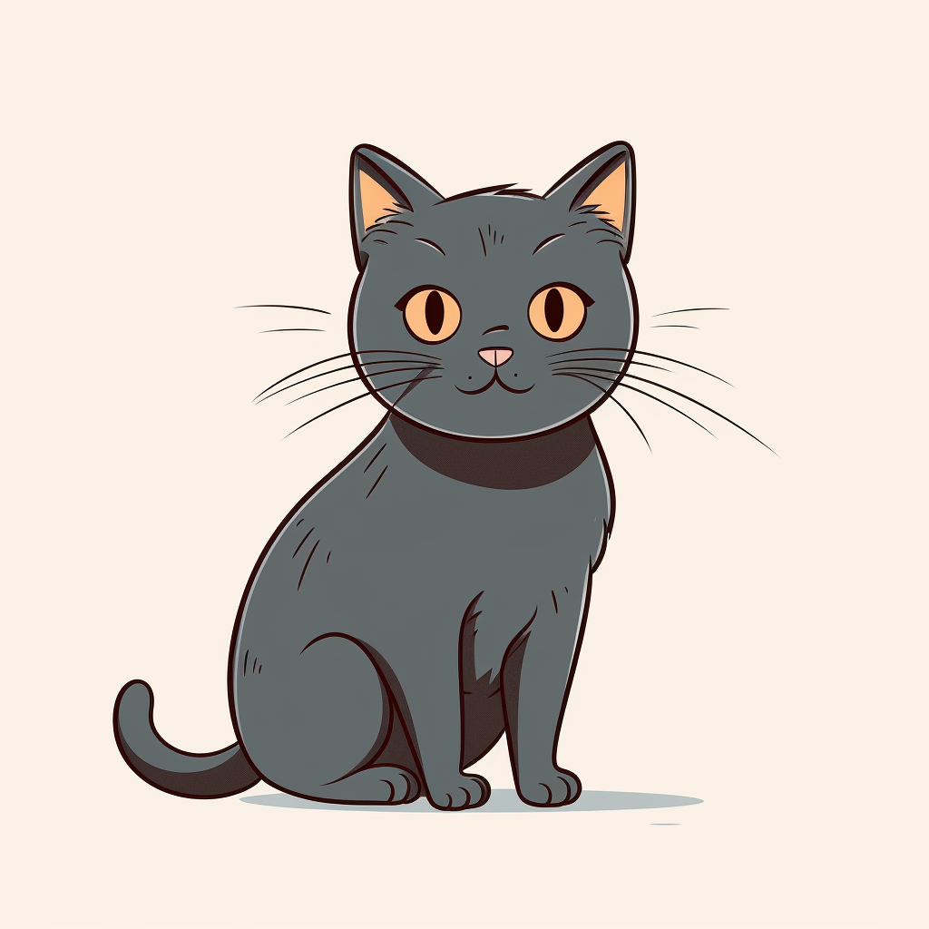
Aa
Bb
Cc
Dd

Slide 4
Aa
Bb
Cc
Dd

Slide 5
Ee
Ff
Gg
Hh

Slide 6
Ee
Ff
Gg
Hh

Slide 7
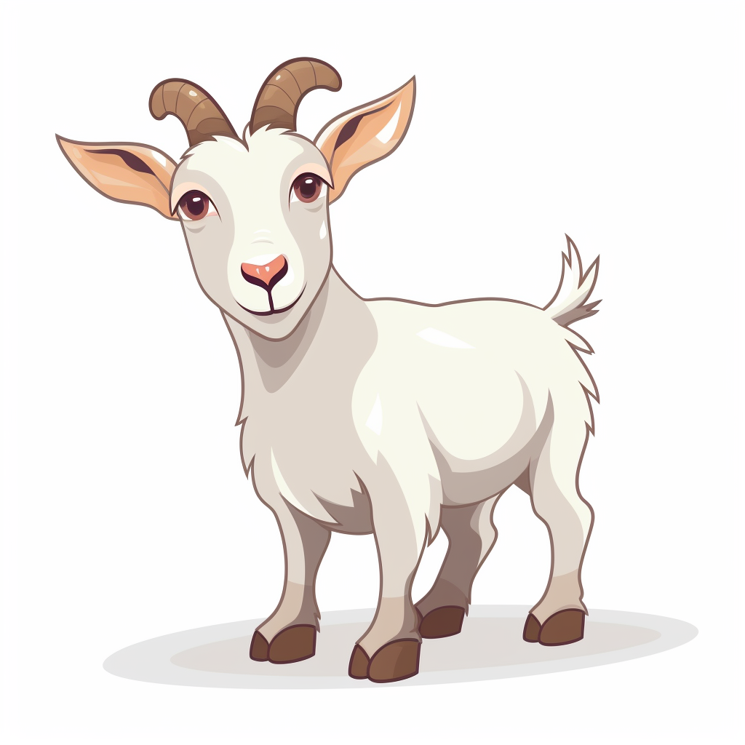
Ee
Ff
Gg
Hh

Slide 8
Ee
Ff
Gg
Hh

Slide 9
Ii
Jj
Kk
Ll

Slide 10
Ii
Jj
Kk
Ll

Slide 11
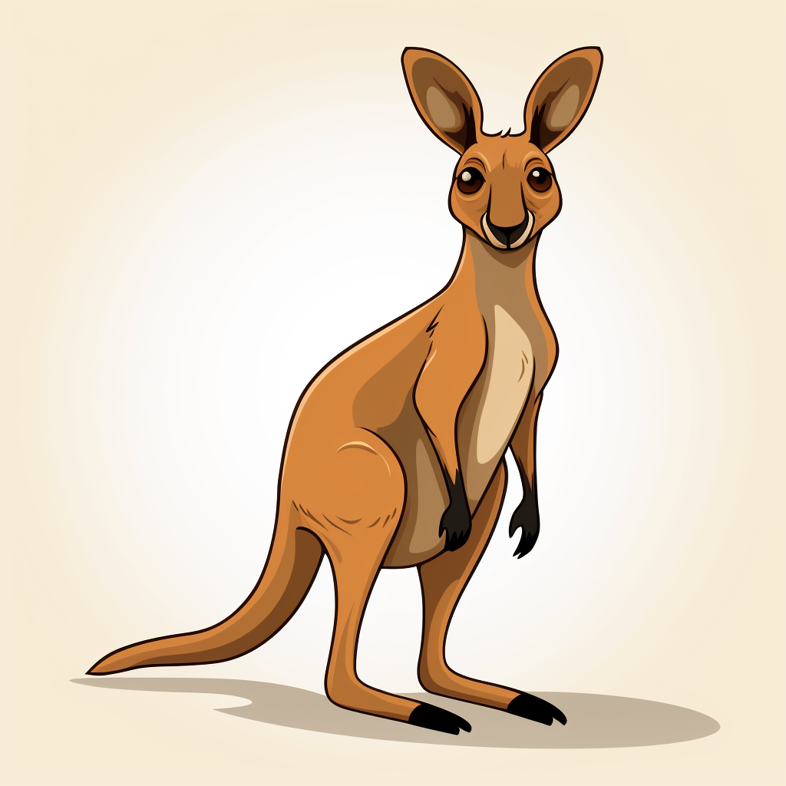
Ii
Jj
Kk
Ll

Slide 12
Ii
Jj
Kk
Ll

Slide 13
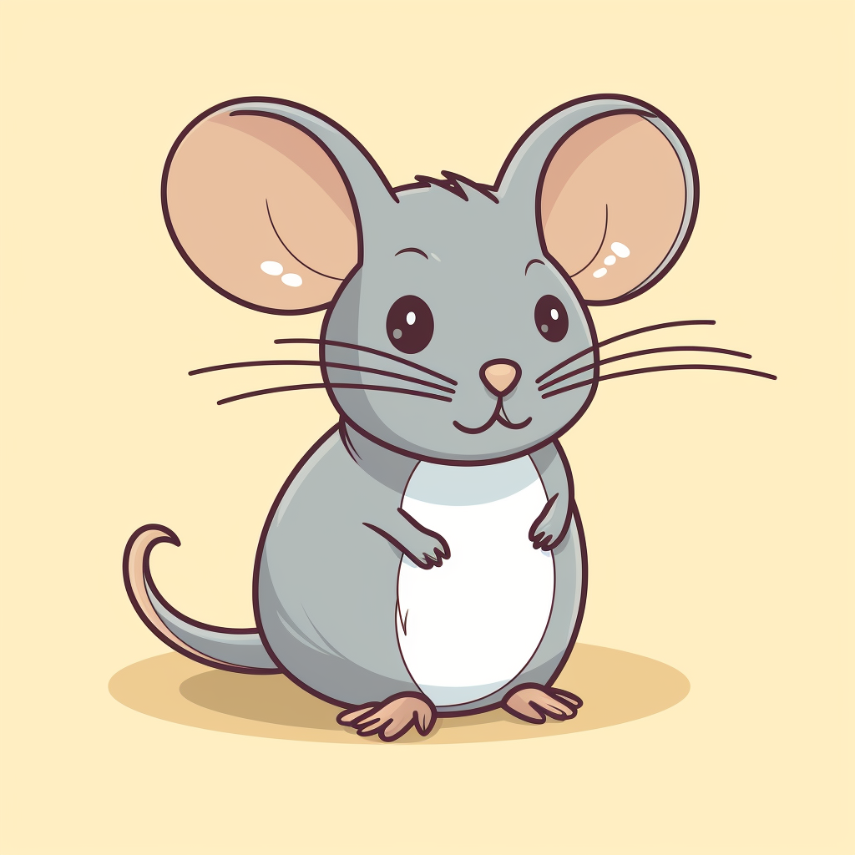
Mm
Nn
Oo
Pp

Slide 14
Mm
Nn
Oo
Pp

Slide 15
Mm
Nn
Oo
Pp

Slide 16
Mm
Nn
Oo
Pp

Slide 17
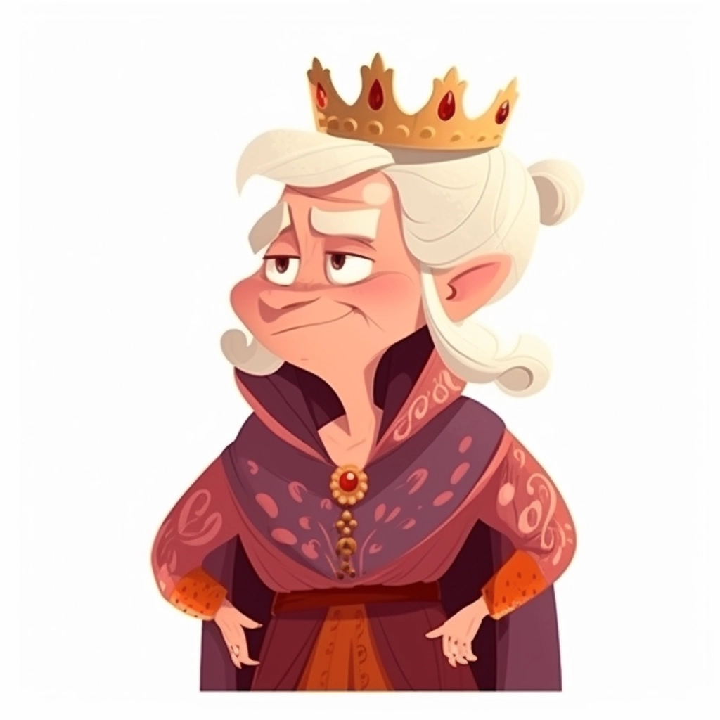
Rr
Ss
Tt
Qq
Ss

Slide 18
Qq
Rr
Ss
Tt

Slide 19
Qq
Rr
Ss
Tt

Slide 20
Qq
Rr
Ss
Tt

Slide 21
Uu
Vv
Ww
Xx

Slide 22
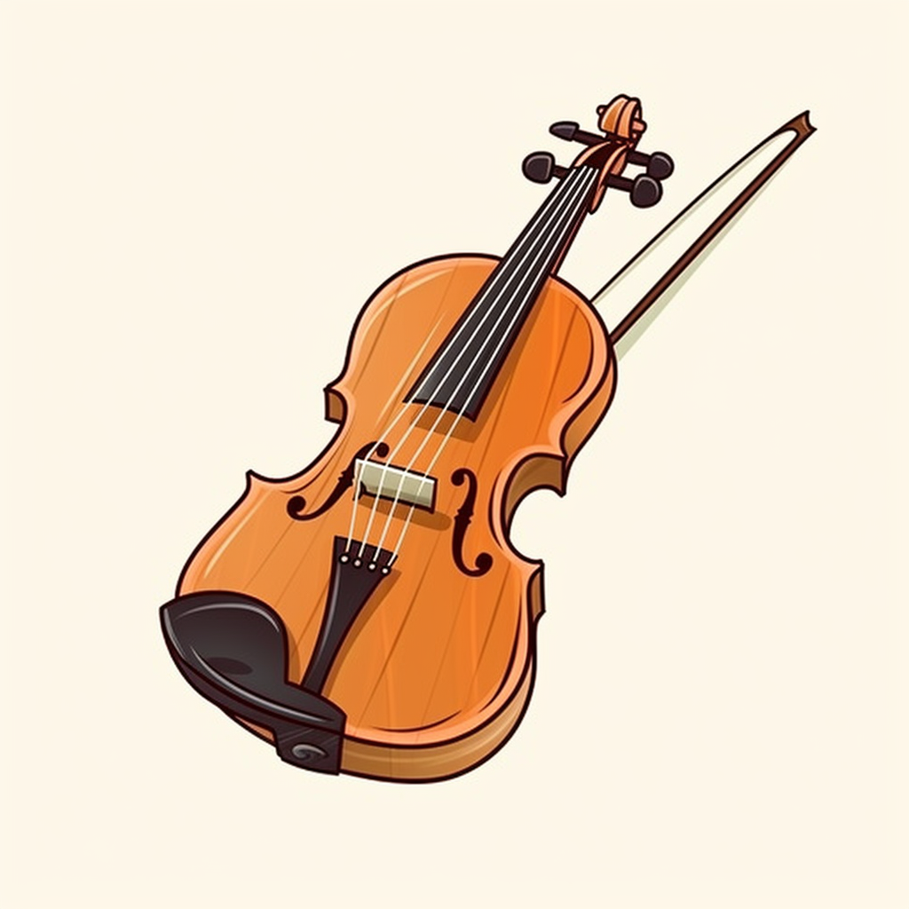
Uu
Vv
Ww
Xx

Slide 23
Uu
Vv
Ww
Xx

Slide 24
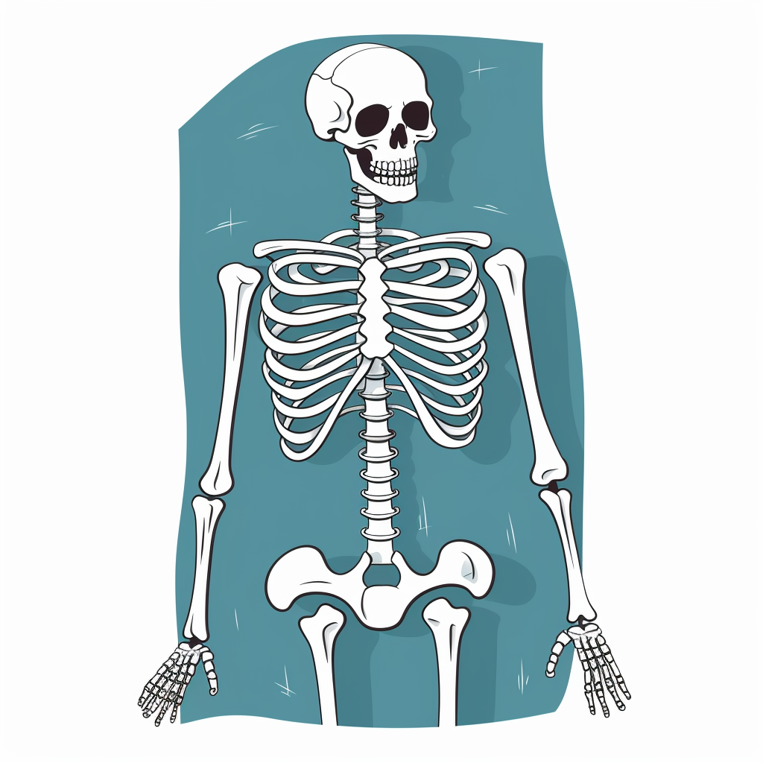
Uu
Vv
Ww
Xx

Slide 25
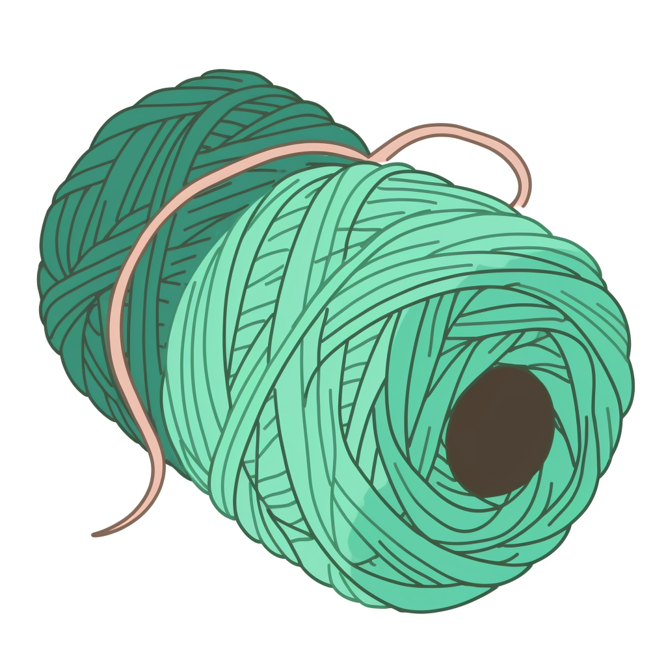
Yy
Zz
Ww
Xx

Slide 26
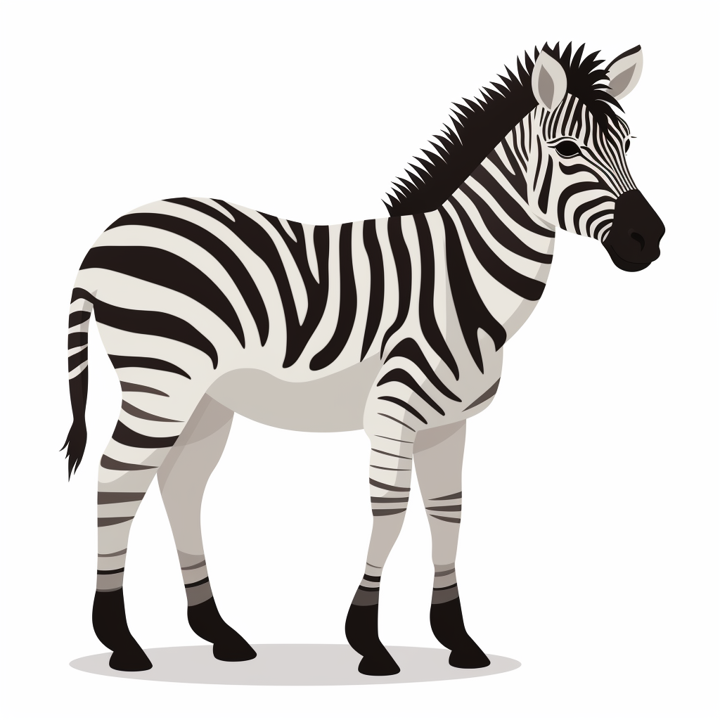
Uu
Vv
Yy
Zz

